Slide 1


Benefits Open Enrollment Week
December 11th – 15th
Notes:
Our presentation will highlight all things you need to know about the benefit plans from Muir Home Health for 2024.

Slide 2

Agenda
Benefits Enrollment
  Dependent Eligibility Verification (DEV) documentation
  HMO enrollees – Finding/Designating a PCP
  Benefits Enrollment
UnitedHealthcare Resources
  Pre-Enrollment Support
  Accessing ID Cards
  UHC App

Slide 3
Benefits Enrollment
https://pennantbenefits.bswift.com
Notes:
Our presentation will highlight all things you need to know about the benefit plans from Muir Home Health for 2024.

Slide 4
Dependent Eligibility Verification
Upload DEV documentation for any newly added dependents
Documents must be uploaded to bSwift within 30 days of enrollment
Acceptable DEV documentation includes:
Dependent | Documentation Required
Spouse | Marriage certificate or Federal/State Tax Return
Domestic Partner | State issued registration, certificate, or license (notarized affidavits are not accepted)
Child | Birth certificate, hospital birth record, adoption certificate, document of legal custody/guardianship, or Federal/State Tax Return
NOTE: Dependents will not be added to coverage until DEV documentation is received/approved.
Notes:
Be aware that if you enroll any dependents in the MHH plans, you will need to upload dependent eligibility verification (DEV) documents to the bSwift enrollment site. These documents will need to be uploaded within 30 days of enrollment.
Acceptable DEV documentation includes:
For a Spouse, copy of the marriage certificate or Federal/State Tax Return
For a Domestic Partner, copy of the state issued registration, certificate, or license (notarized affidavits are not accepted)
For a child, a copy of the birth certificate, hospital birth record, adoption certificate, document of legal custody/guardianship, or Federal/State Tax Return
Dependents will not be added to active coverage until DEV documentation is received and approved.

Slide 5
Selecting a Primary Care Physician (PCP)
(For HMO Plan)
Steps to Select a Primary Care Physician (PCP)
Go to myuhc.com
Select Find a Provider under the Find a Doctor tile
Choose Medical Directory
Choose Employer and Individual Plans
Choose UHC Member
Scroll down and Select the SignatureValue Plans
Select the State in which you live
Choose your Health Plan Network (select Signature Value HMO)
Enter your Home Address or Zip Code
Select your PCP by Category
PCP number will be located under the Provider ID

Slide 6
UnitedHealthcare Resources
Notes:
Our presentation will highlight all things you need to know about the benefit plans from Muir Home Health for 2024.

Slide 7
UHC – Pre-Enrollment Support
Pre-Enrollment Support Available
For Medical (PPO Plans) ~ Call 1-866-633-2446
For Medical (HMO Plan) ~ Call 1-800-624-8822
UHC Advocates can provide pre-enrollment support for medical & prescription benefits
Phone Prompts:
  Advise you are a “member”
  Advise you “do not have your UHC member number”
  Advise you are calling for “medical benefits” or “prescription benefits”
  Once connected, advise my employer is Muir Home Health #934060, and we are transitioning to UHC as of 01/01/2024

Slide 8
Medical/Prescription ID Cards
Medical/Prescription ID cards will not be in hand by 01/01/2024
  ID cards are generated 3-5 business days after enrollment information is received
  Allow additional 7-10 business days for mail delivery
Medical/Prescription ID cards will be accessible via the UnitedHealthcare app
  See separate flyer titled Myuhc.com Registration Steps
  Access ID Cards
  Access Claim details
For the PPO Plans ~ all members will be listed on the Medical/Prescription ID card
  1 pair of ID cards will be issued per family
  Additional cards may be requested by contacting UHC, via the website, or via the UnitedHealthcare app
For the HMO Plan ~ each covered member will receive his/her own ID card

Slide 9
Dental ID Card
Dental ID cards are not mailed
You may access your dental ID card in 2 ways:
  Via the myuhc.com
  Via the UnitedHealthCare app
You do not need a dental ID card to get dental care. Your dental office only needs your member number or other identifying personal information to verify you are a UHC member.
Dental Customer Service: 1-877-816-3597

Slide 10
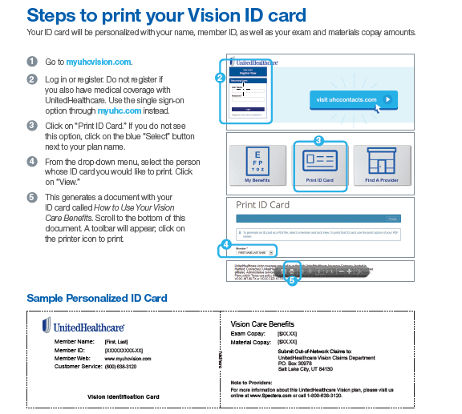
Vision ID Card
Vision ID cards are not mailed
You may print a Vision ID card (see instructions on the left)
Vision Customer Service: 1-800-638-3120

Slide 11

UHC Mobile App
UHC Mobile App
The UnitedHealthcare® App puts your plan at your fingertips.
Provides secure on-the-go access to personalized health plan information.
When you’re out and about, you can do everything from managing your plan to getting convenient care. Just download the app to:
  Find nearby care options in your network
  Estimate costs
  Video chat with a doctor 24/7
  View and share your health plan ID card
  See your claim details and view progress toward your deductible

Slide 12
Notes:
Our presentation will highlight all things you need to know about the benefit plans from Muir Home Health for 2024.

